Slide 1

Energy Conservation
@ChallneyBoys

Slide 2
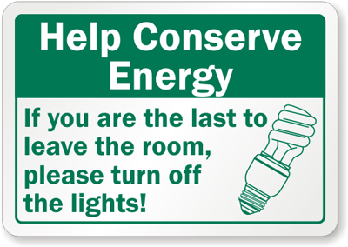

Energy Conservation for
Challney High School for Boys

Slide 3

Our Challney Boys

Slide 4
What is Energy Conservation?
Energy conservation is using energy efficiently to reduce wastage.
Using energy mindfully as some sources are non-renewable thus we need to use it in a manner that ensure the future will have enough.
This is known as sustainability.

Slide 5

To reduce energy usage at Challney Boys school to keep in line with the Department of Educations policy to have all schools becoming net zero.
Aim of the Project

Slide 6

Plan of action
Install motion sensor light switches in all classrooms
Change our appliances
Expand our Challney Green roles
We strongly believe that the installation of these energy saving mediums in our classrooms will greatly reduce our energy use.

Slide 7
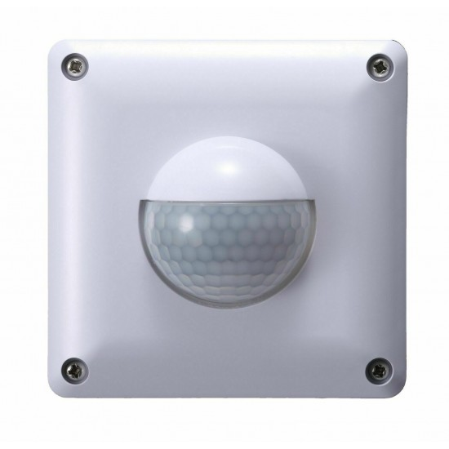
Effectiveness of Motion Switches
According to Ellen Sarkisian in her article posted on the Ecoguide.org website motion sensor light switches can reduce energy consumption by 35-45 percent, and can go up to as high as 75 percent.
Reference.

Slide 8
Current usage and projected savings
Without motion sensor switch
July 2023
23,103.5 KWh = £8,815.48
November 2022
31,939.8 = £11,646.73
December 2022
32,021.9 = £11,704.62
January 2023
37,592.4 = £14,819.63
With motion sensor switch
July 2023
Usage would be 15,017.275 KWh
November 2022
Usage would be 20,760.87 KWh
December 2022
Usage would be 20,814.235 KWh
January 2023
Usage would be 24,435.06

Slide 9
Potential Savings to School
November 2022
Savings would be 11178.93 KWh saving £4136.20
December 2022
Savings would be 11207.665 KWh saving £4146.84
July 2023
Saving would be 8086.225 kWh saving £2991.90
January 2023
Savings would be 13157.34 kWh £4868.22

Slide 10
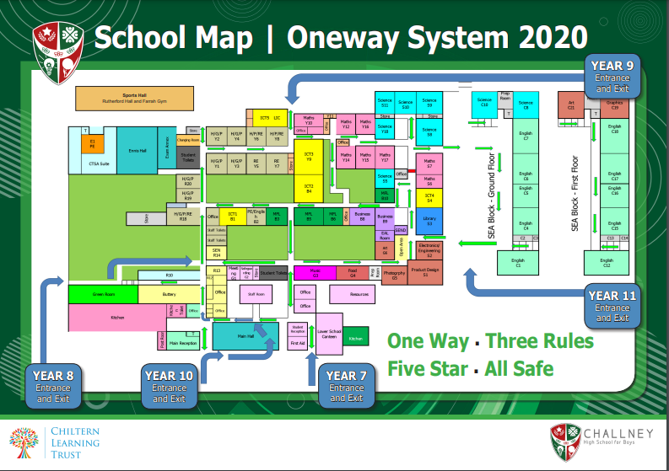
Number of Rooms

Slide 11

Potential Savings to School
75 rooms
75 x £15(per switch) = £ 1125
Labour costs £60 per hour
12 hours labour
£720 labour costs
£720+£1125
£1845 total, which is £1146.90 less than our lowest cost saved, which is a small price to pay for the long term impact on the environment and school’s finance.

Slide 12

Plan of Action
Expand the roles of the Challney Green team
The Green team is a group of students whose responsibility will be to remind everyone to switch off electrical devices when not in use.
This will be our sustainability plan to ensure that our actions and plans will live on with the incoming new members of this club.

Slide 13
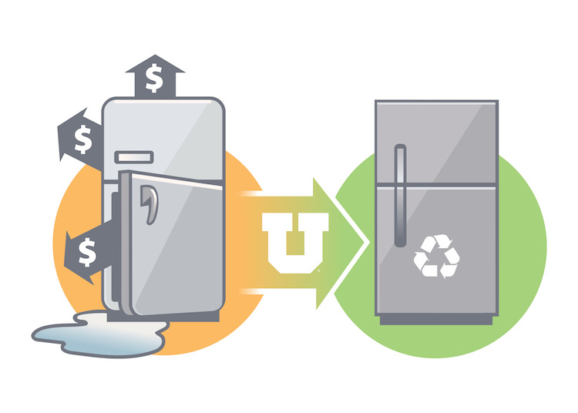
Plan of Action
Replacing old appliances
Old appliances are prone to be less efficient in their operations. We will conduct and inventory of the age of our resources make recommendations to the school and trust about having them replaced with more efficient ones.

Slide 14
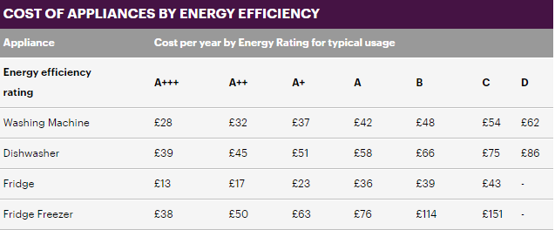
Plan of Action
On average, per year, a newer fridge-freezer could save up to £113 per month. That’s one of many examples.
This may sound little, but adds up over time in order to save money and reduce emissions
Source

Slide 15
Plan of Action
Energy reducing day - Green day
We believe that if we could have at least one day per month or week when we limit the use of electronic devices in the entire school there would be a reduction in our energy consumption.

